Slide 1
quality assessment for video frames
Deepak Kumar, Mohit Sharma, Sushant Verma & Amit Sachan

Slide 2
Objective & Description
To assess the quality of extracted frames from video.
The process of determining the level of accuracy is called Image Quality Assessment (IQA).
Some common factors may affect the quality of an image
Blurriness make the image less sharp, sharpness determines the amount of detail an image can convey.
Noise is a random variation of image density, visible as grain in film and pixel level variations in digital images.
Contrast is the slope of the tone reproduction curve in a log-log space. High contrast usually involves loss of dynamic range — loss of detail, or clipping, in highlights or shadows.
Distortion is an aberration that causes straight lines to curve. It can be troublesome for architectural photography and metrology.
Dynamic range is closely related to noise: high noise implies low dynamic range.

Slide 3
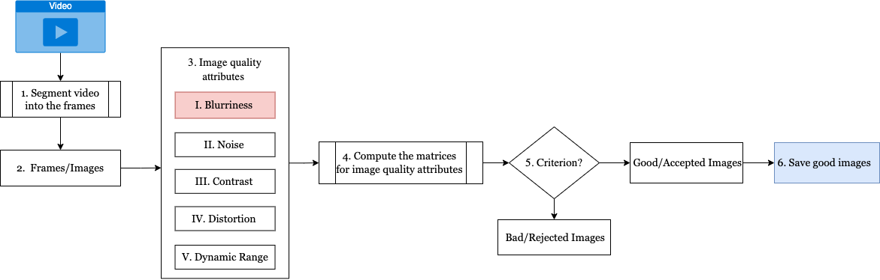
HLD for Image Quality Assessment (IQA)

Slide 4
Blurriness
Blurriness makes the image less clear or distinct.
The colour transition from one side of an edge in the image to other is smooth rather than sudden. The effect is to average out rapid changes in pixel intensity.
Four type of blurriness
Motion blur: which is caused by the relative motion between camera and scene objects
Defocus blur: which is caused by the visual imaging system.
Gaussian blur: Blur function are usually approximated by the Gaussian function for a large range of devices like optical image camera, microscope, telescope, etc.
Box blur: It is a mean filter where each pixel in the output image has mean of its neighbouring pixels defined in some specific region in the input image.

Slide 5
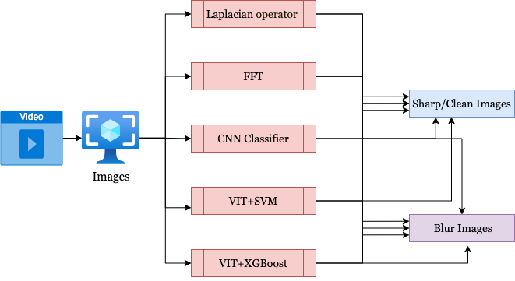
Blurriness Detection techniques
Two types of blur detection techniques are utilized
Mathematical operators such as
Laplacian operator
Fast Fourier transform (FFT)
ML/DL Techniques
Vision transformer (VIT) + ML Classifiers (SVM & XG Boost)
CNN

Slide 6
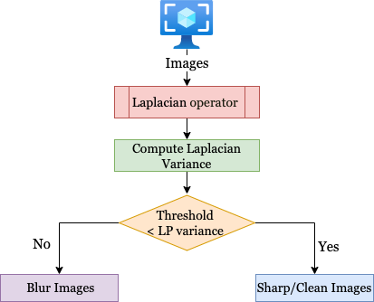
Laplacian operator
Laplacian operator to discover edges in a picture.
It is used to measure the 2nd derivative of an image.
The Laplacian highlights the regions of an image containing rapid intensity changes, much like the Sobel and Scharr operators.
Take a single channel of an image and convolve it with the following 3 x 3 kernel:
Compute the variance (i.e. standard deviation squared) of the response.
If the variance falls below a pre-defined threshold, then the image is considered blurry; otherwise, the image is not blurry.
0 | 1 | 0
1 | -4 | 1
0 | 1 | 0

Slide 7


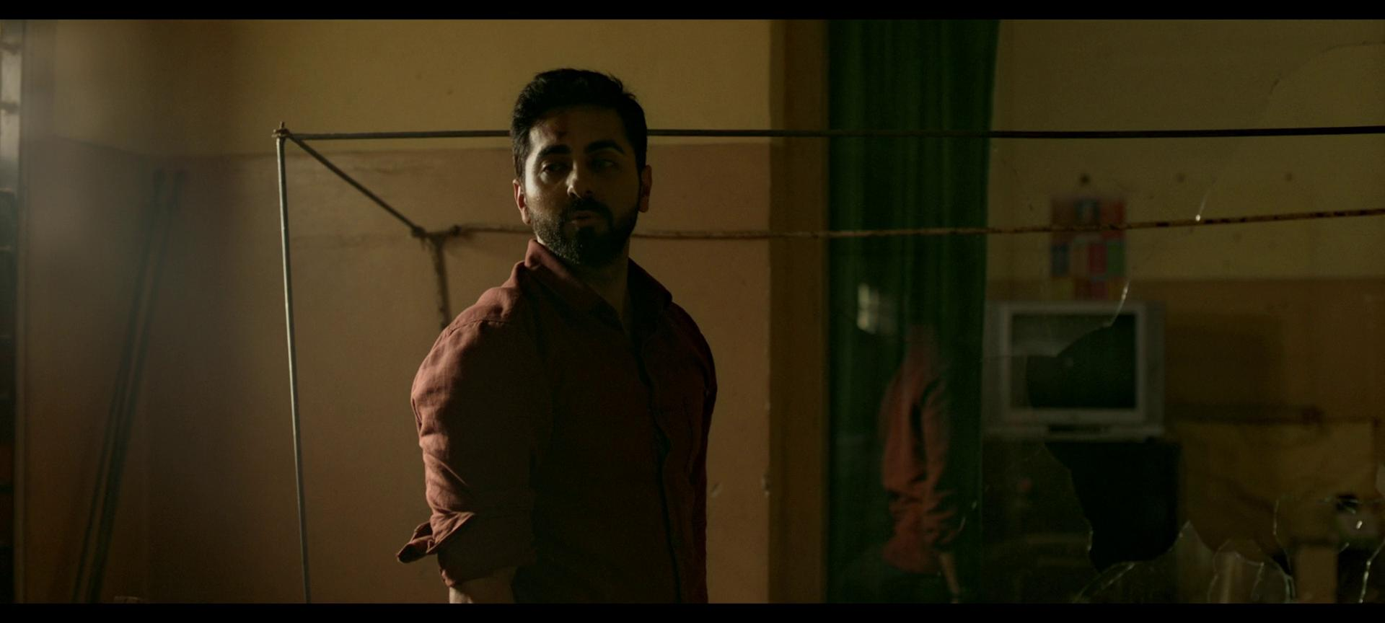



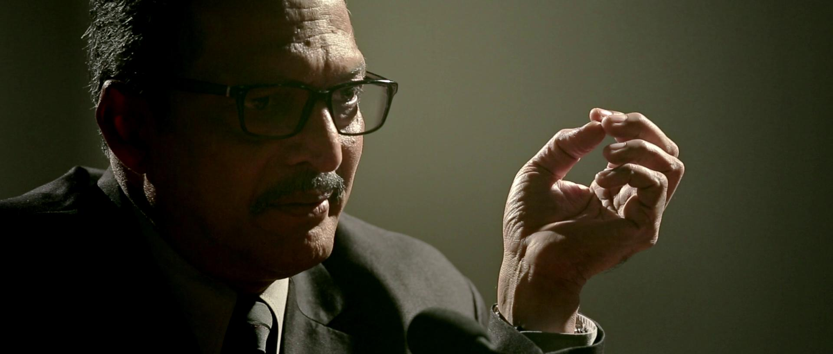


Laplacian-sample results (Threshold- 1500)
228.6
347.9
428.5
581.9
765.3
1170
2143.4
2988.6
7133.1

Slide 8


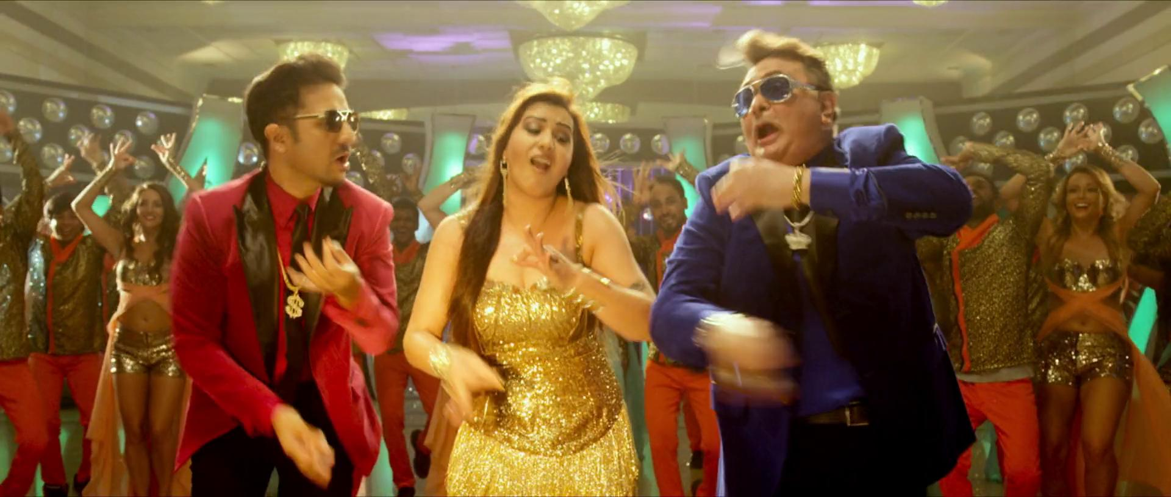

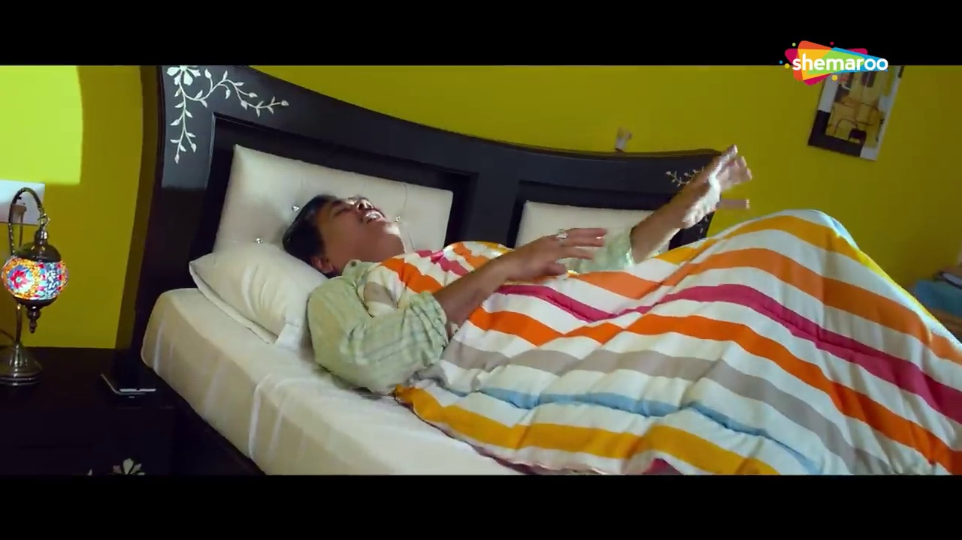



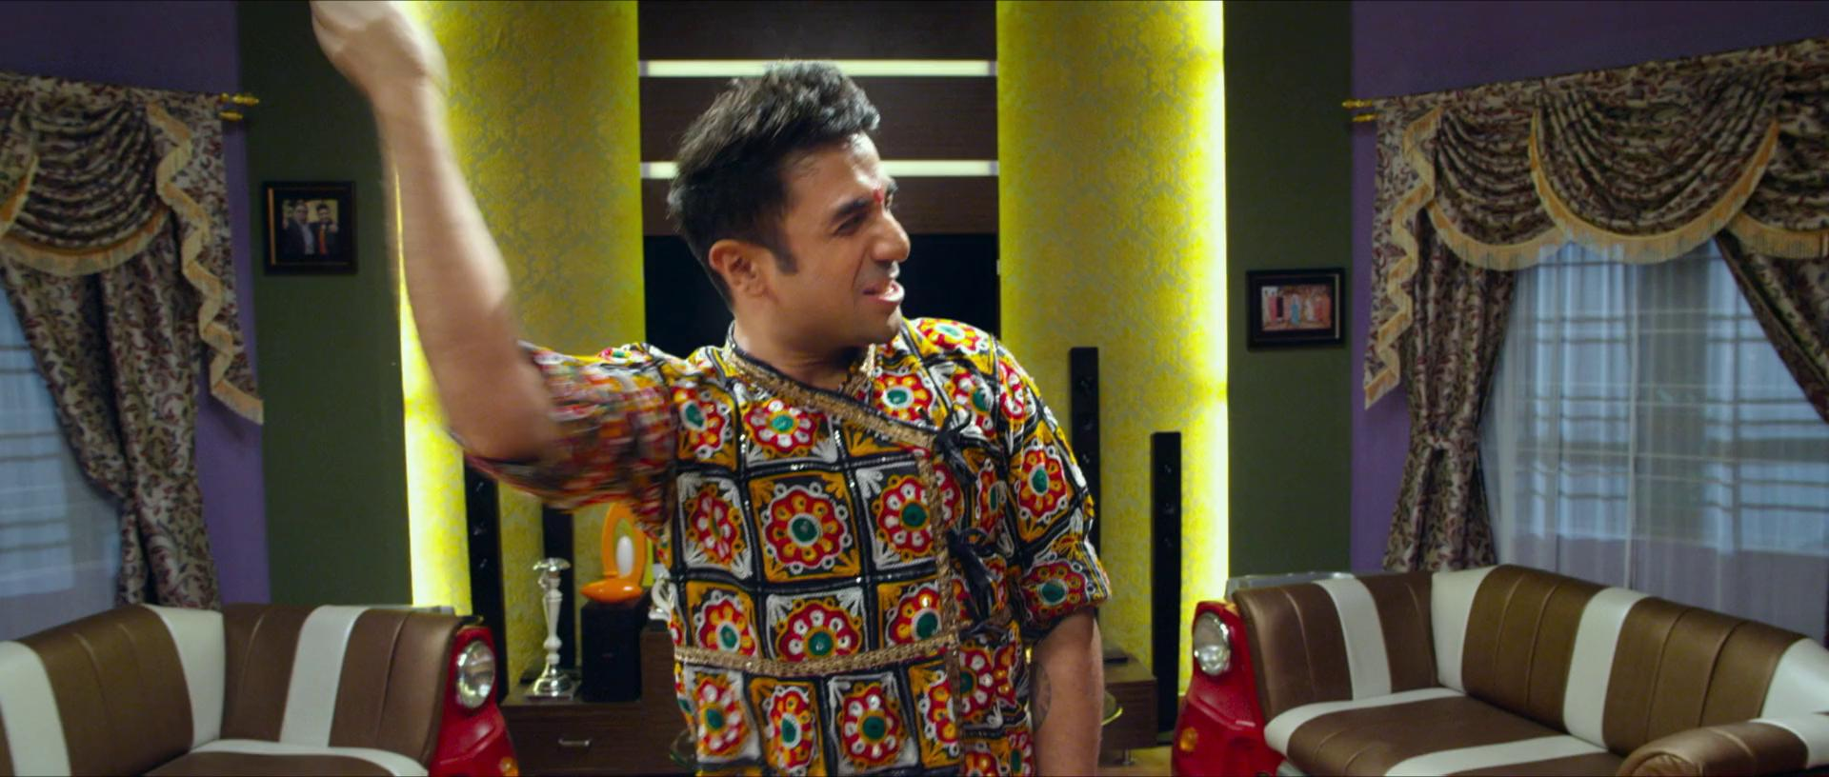
Laplacian-False Negative
1856.8
2005.2
2239.5
2349.8
2400.6
2772.6
2966.6
3281.3
3963.4

Slide 9
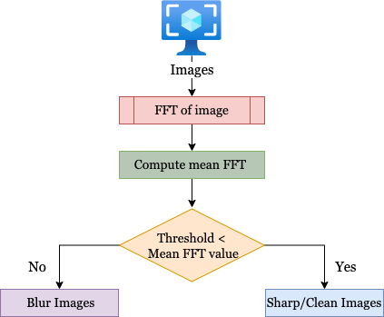
Fast Fourier Transform (FFT)
The Fast Fourier Transform is a convenient mathematical algorithm for computing the Discrete Fourier Transform. It is used for converting a signal from one domain into another.
The FFT can be used as an image processing tool that represents an image in two domains:
Fourier (i.e., frequency) domain
Spatial domain
The FFT represents the image in both real and imaginary components.
By analysing mean FFT values, we can perform blur detection.
If the mean FFT value is below a pre-defined threshold, then the image is considered blurry; otherwise, the image is not blurry.

Slide 10
Laplacian-sample results (Threshold- 0.71)
0.12
0.36
0.59
0.59
0.61
0.81
0.89
1.49
1.82

Slide 11
Laplacian-False Negative (Threshold- 0.71)
0.59
0.55
1.43
1.43
1.0
1.08
1.55
1.61
1.64

Slide 12
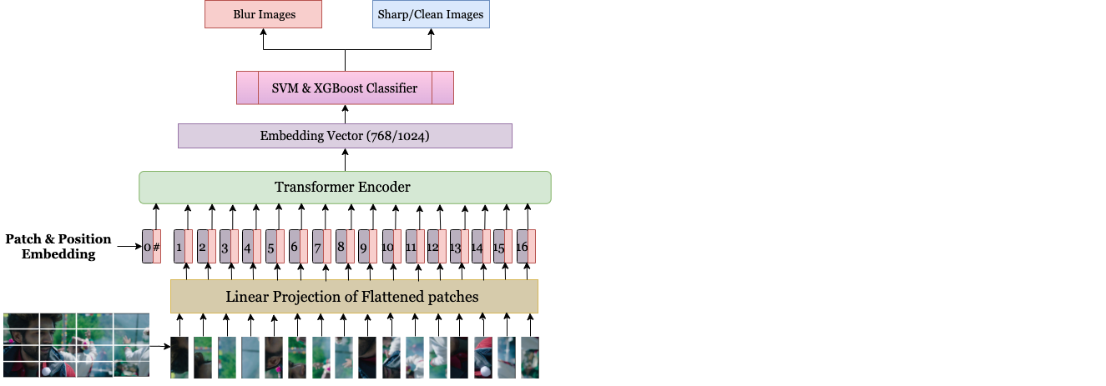
ViT+ SVM & ViT+ XGBoost for blurriness Detection
Transformer encodes a sequence of input tokens and decodes the encoded representation to match the sequence of target tokens.
The standard transformer takes a 1-D sequence of token embeddings as input.
To handle 2-D images, the input image is first divided into N by N patches and creating 3(RGB)*N² smaller “image tokens”.
The 3-D patches (height x width x channels) are then flattened into 1-D.
Transformer uses constant latent vector size D for all layers.
The flattened patches are mapped to D dimensions with a trainable linear projection.
The result sequence is called embeddings.

Slide 13
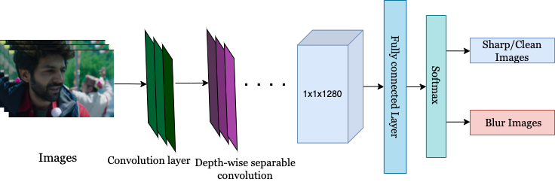
MobileNet V2 for blurriness Detection
MobileNet v2 is used to proposed a unified solution for blur detection.
It uses depth wise separable convolution which is cheaper as compared to normal convolution
Its building block is the residual connection. This works just like in ResNet and exists to help with the flow of gradients through the network.
Each layer has batch normalization and the activation function is ReLU6. However, the output of the projection layer does not have an activation function applied to it.
The input image is 224×224×3 and the output of the network is a 1×1×1280 feature map.
MACs (millions)-300
Parameters (millions)- 3.47

Slide 14
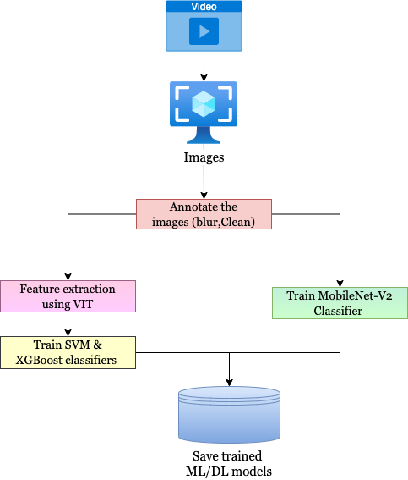
Train the ML/DL models
14k images are annotated- 5.5k “Clean” and -8k “Blur”.
Two versions of ViT are used to obtain the feature vector (768/1024) for image.
Vit-base-patch16-224, embedding- 1x768
Vit-large-patch16-384, embedding- 1x1024
SVM and XGBoost classifiers are trained on both the extracted feature vectors.
Trained classifiers are used to classify the images to “Clean” and “Blur”.
MobileNet v2
It is also trained on the annotated dataset 13.5 k.
Epoch- 50
Batch size- 32
Learning rate- 5 e⁻⁴

Slide 15
Training Results
Model | Threshold | Accuracy | True positive | False Positive | False Negative | True Negative
ViT-large+XGBoost | Roc | 0.999
 | Threshold- 0.77 | 0.998 | 1017 | 0 | 3 | 1691
ViT-base+XGBoost | Roc | 0.999
 | Threshold- 0.78 | 0.999 | 1016 | 1 | 1 | 1693
ViT-large+SVM | Roc | 1.0
 | Threshold- 0.5 | 1.0 | 1013 | 0 | 0 | 1698
ViT-base+SVM | Roc | 1.0
 | Threshold- 0.5 | 1.0 | 1013 | 0 | 0 | 1698
MobileNet V2 | Roc | 0.998 | Validation loss | 0.0065
 | Threshold- 0.5 | 0.998 | 1017 | 0 | 3 | 1691

Slide 16
Test Results
Model | Accuracy | True positive | False Positive | False Negative | True Negative
FFT | 0.571 | 73 | 55 | 29 | 39
Laplacian operator | 0.642 | 72 | 56 | 15 | 53
ViT-base+XGBoost | 0.668 | 74 | 50 | 11 | 57
ViT-base+SVM | 0.622 | 82 | 42 | 28 | 40
ViT-large+XGBoost | 0.693 | 100 | 28 | 32 | 36
ViT-large+SVM | 0.826 | 124 | 4 | 30 | 38
MobileNet V2 | 0.897 | 113 | 15 | 5 | 63

Slide 17
Vit-large-SVM: Sample results
0.12
0.36
0.59
0.59
0.61
0.81
0.89
1.49
1.82

Slide 18
Laplacian-False Negative (Threshold- 0.71)
0.59
0.55
1.43
1.43
1.0
1.08
1.55
1.61
1.64

Slide 19

MobileNet v2- False Negative
0.946
0.907
0.976
0.997
0.996

Slide 20


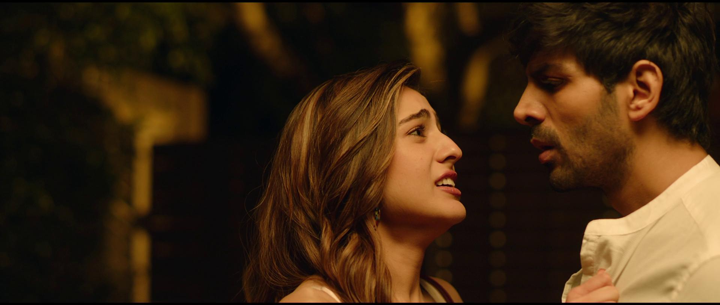

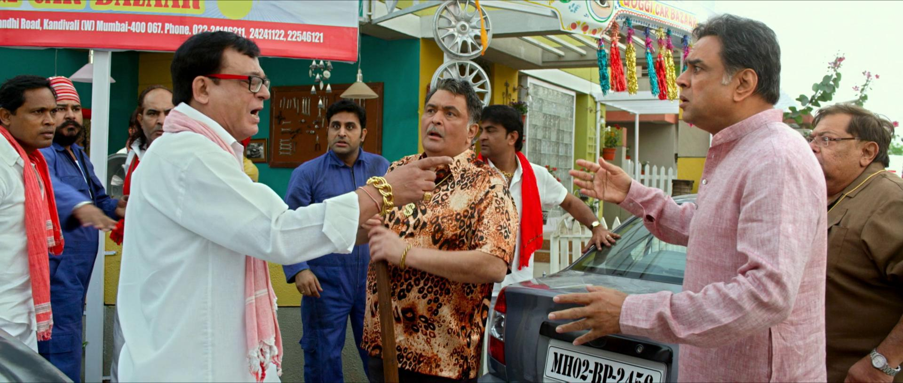
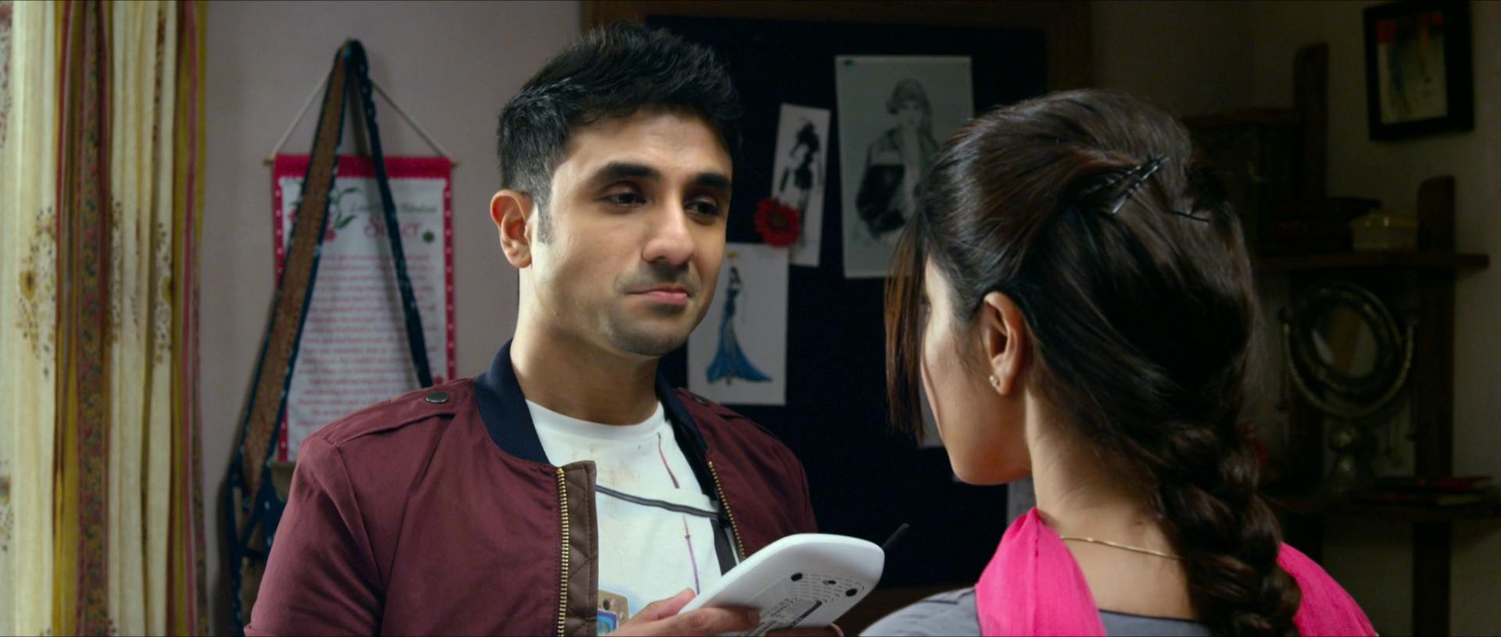
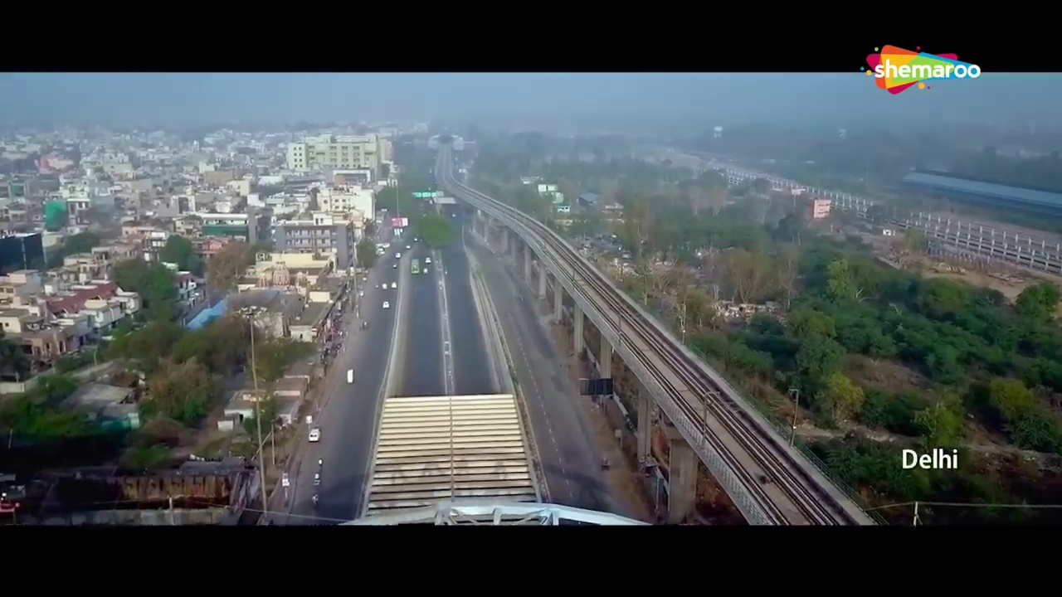
MobileNet v2- False Positive
0.693
0.99
0.991
0.99
0.94
0.99
0.92
0.91
0.53

Slide 21
Thank You

